Slide 1
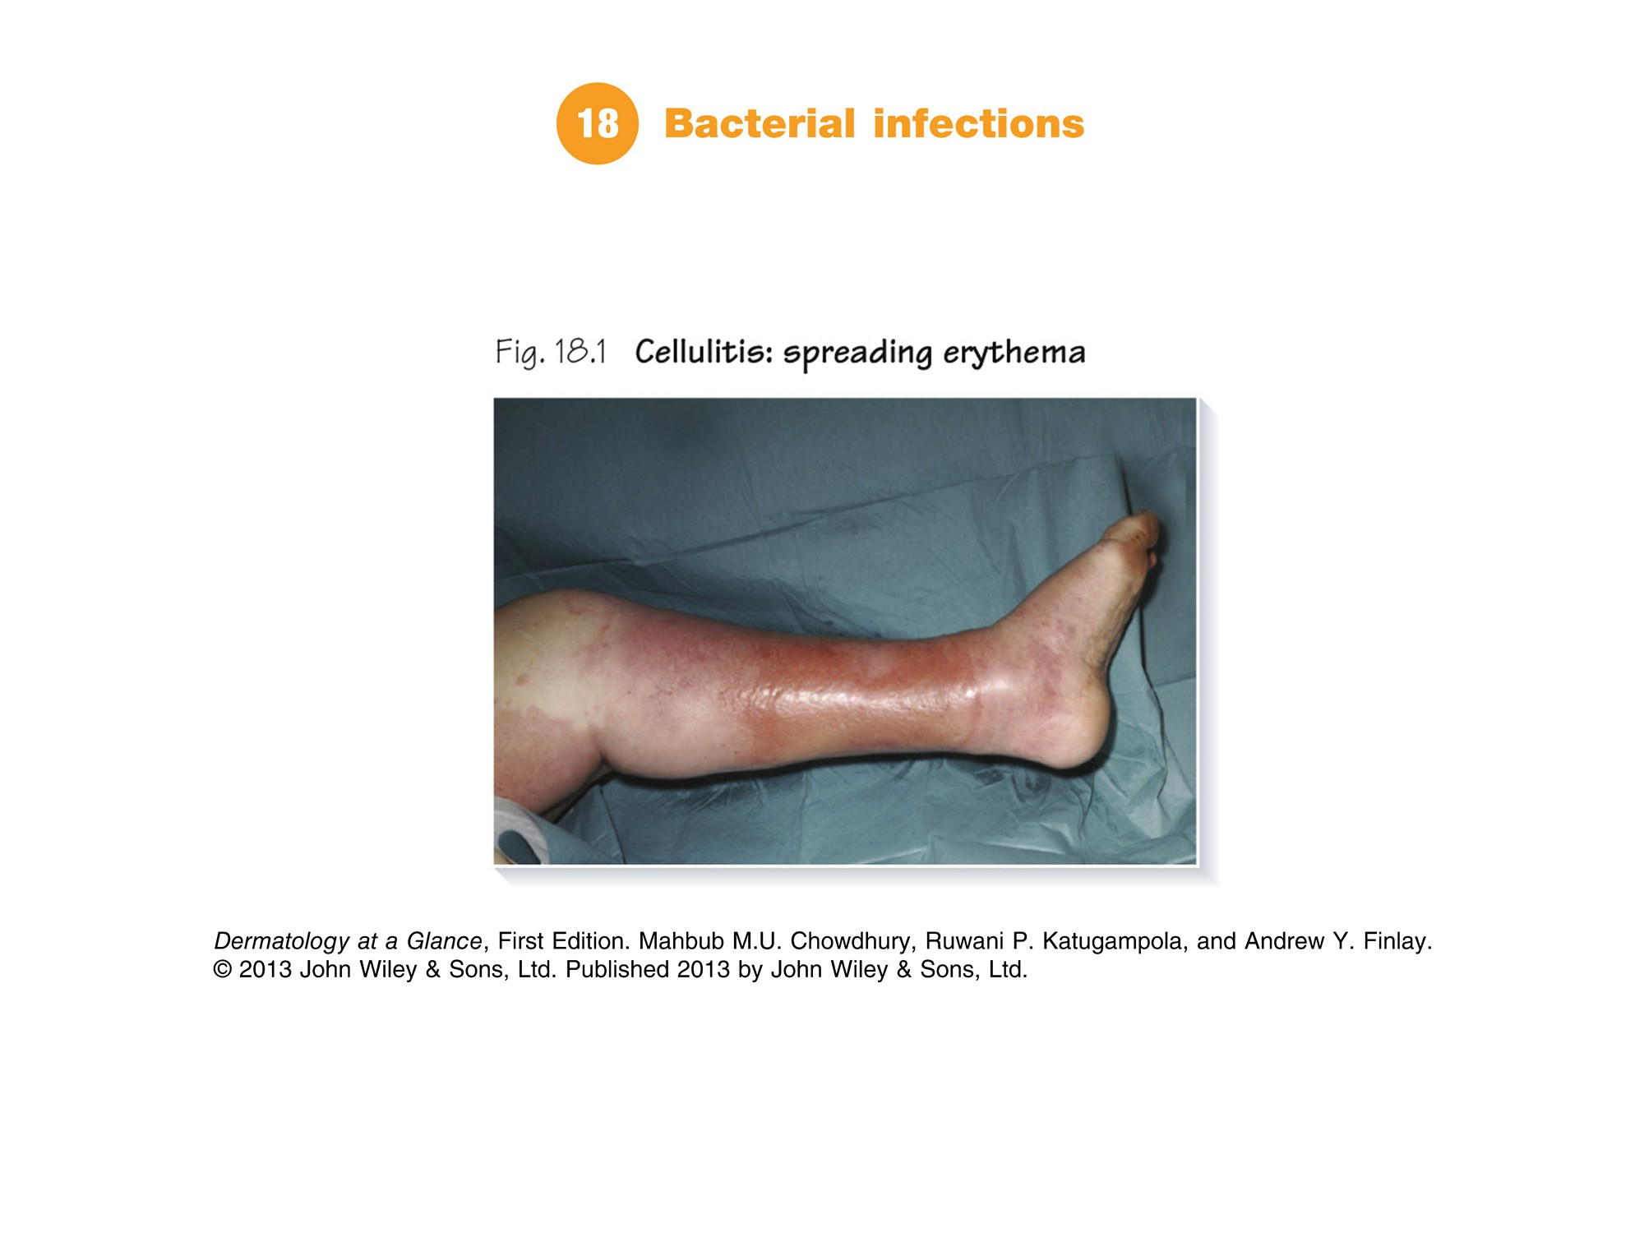
Notes:
Part 7 Skin infections
Chapter 18 Bacterial infections | Chapter 19 Viral infections | Chapter 20 Fungal infections | Chapter 21 Skin infestations | Chapter 22 Tropical skin disease

Slide 2
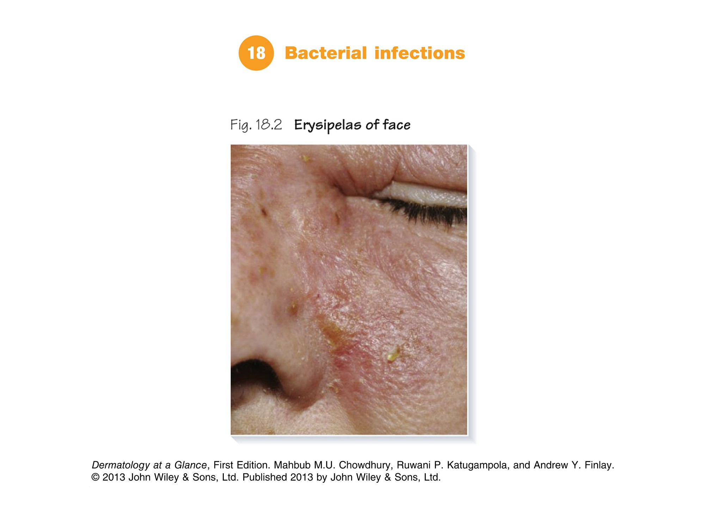

Slide 3
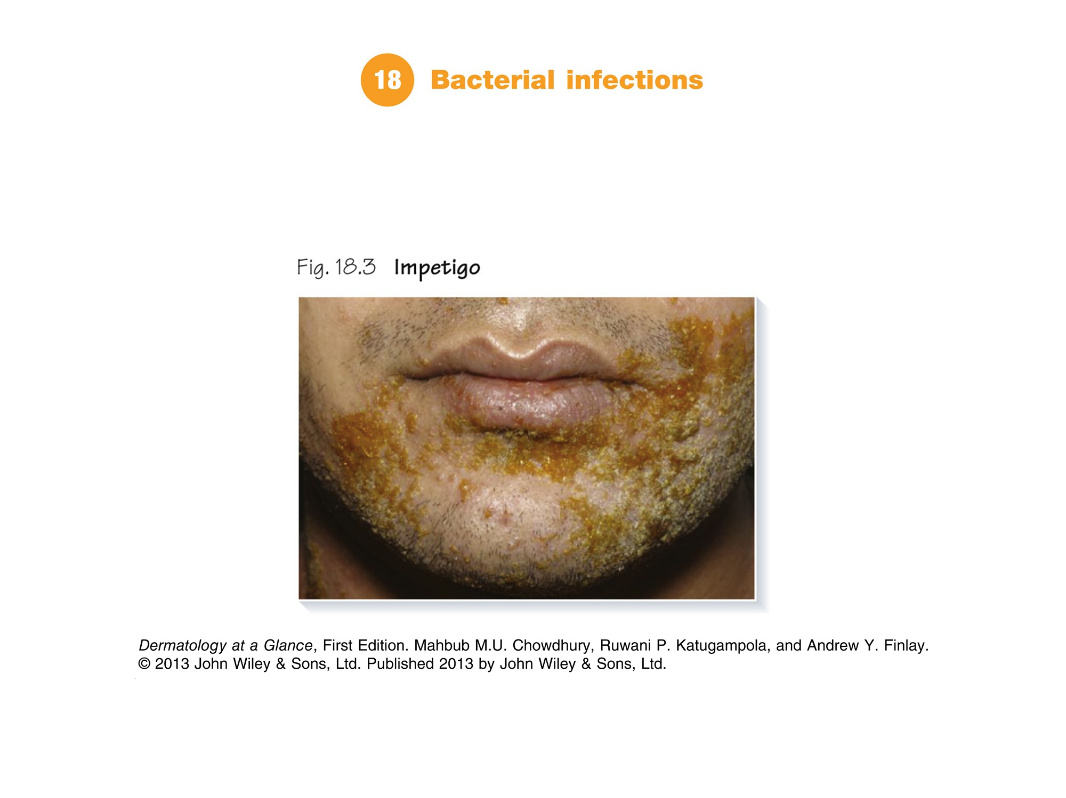

Slide 4
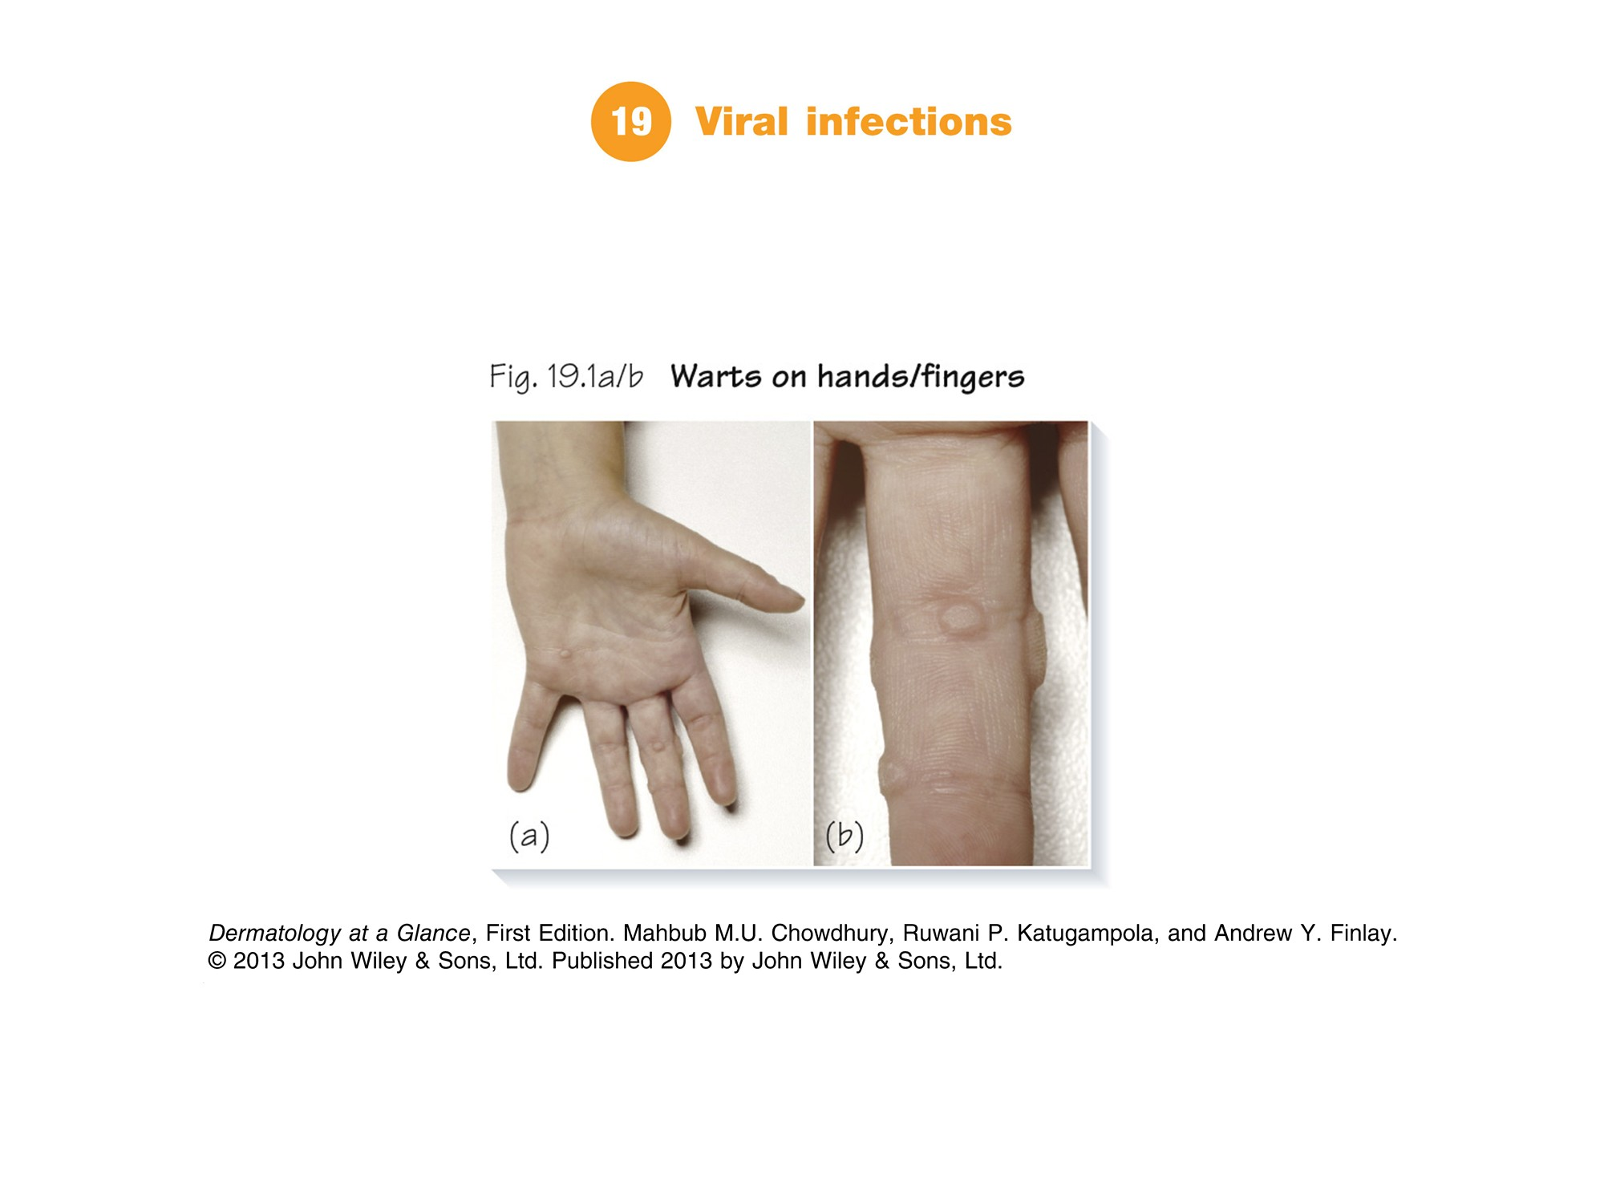

Slide 5
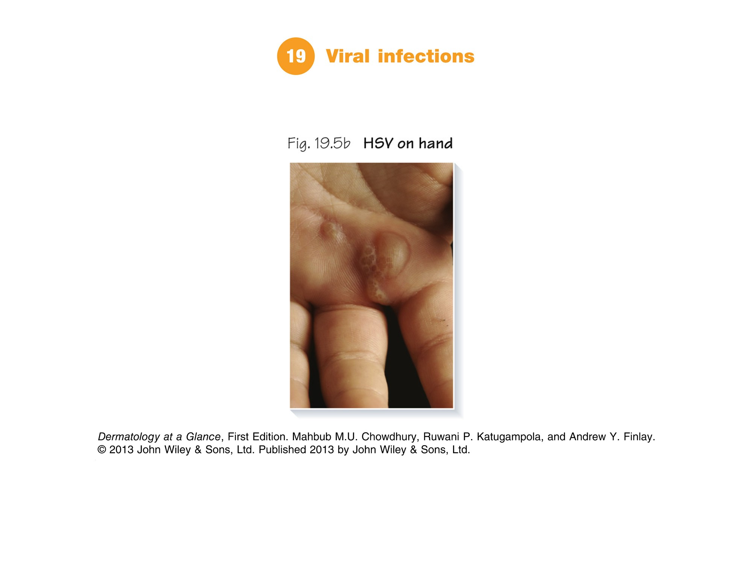

Slide 6
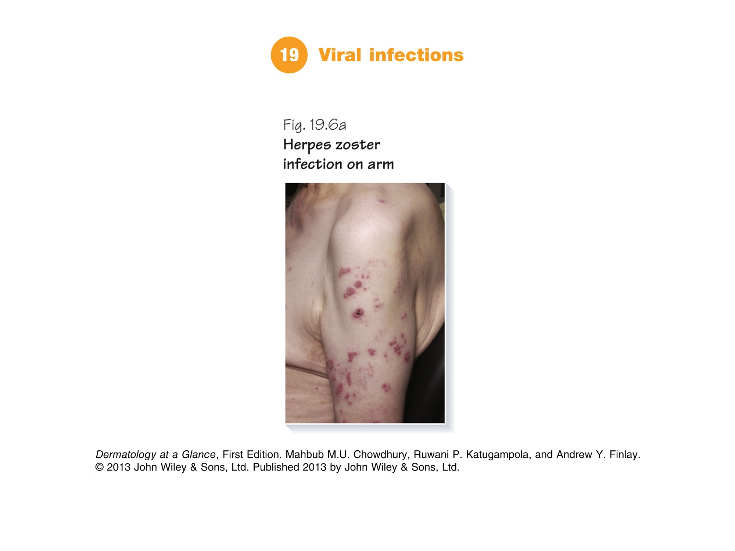

Slide 7
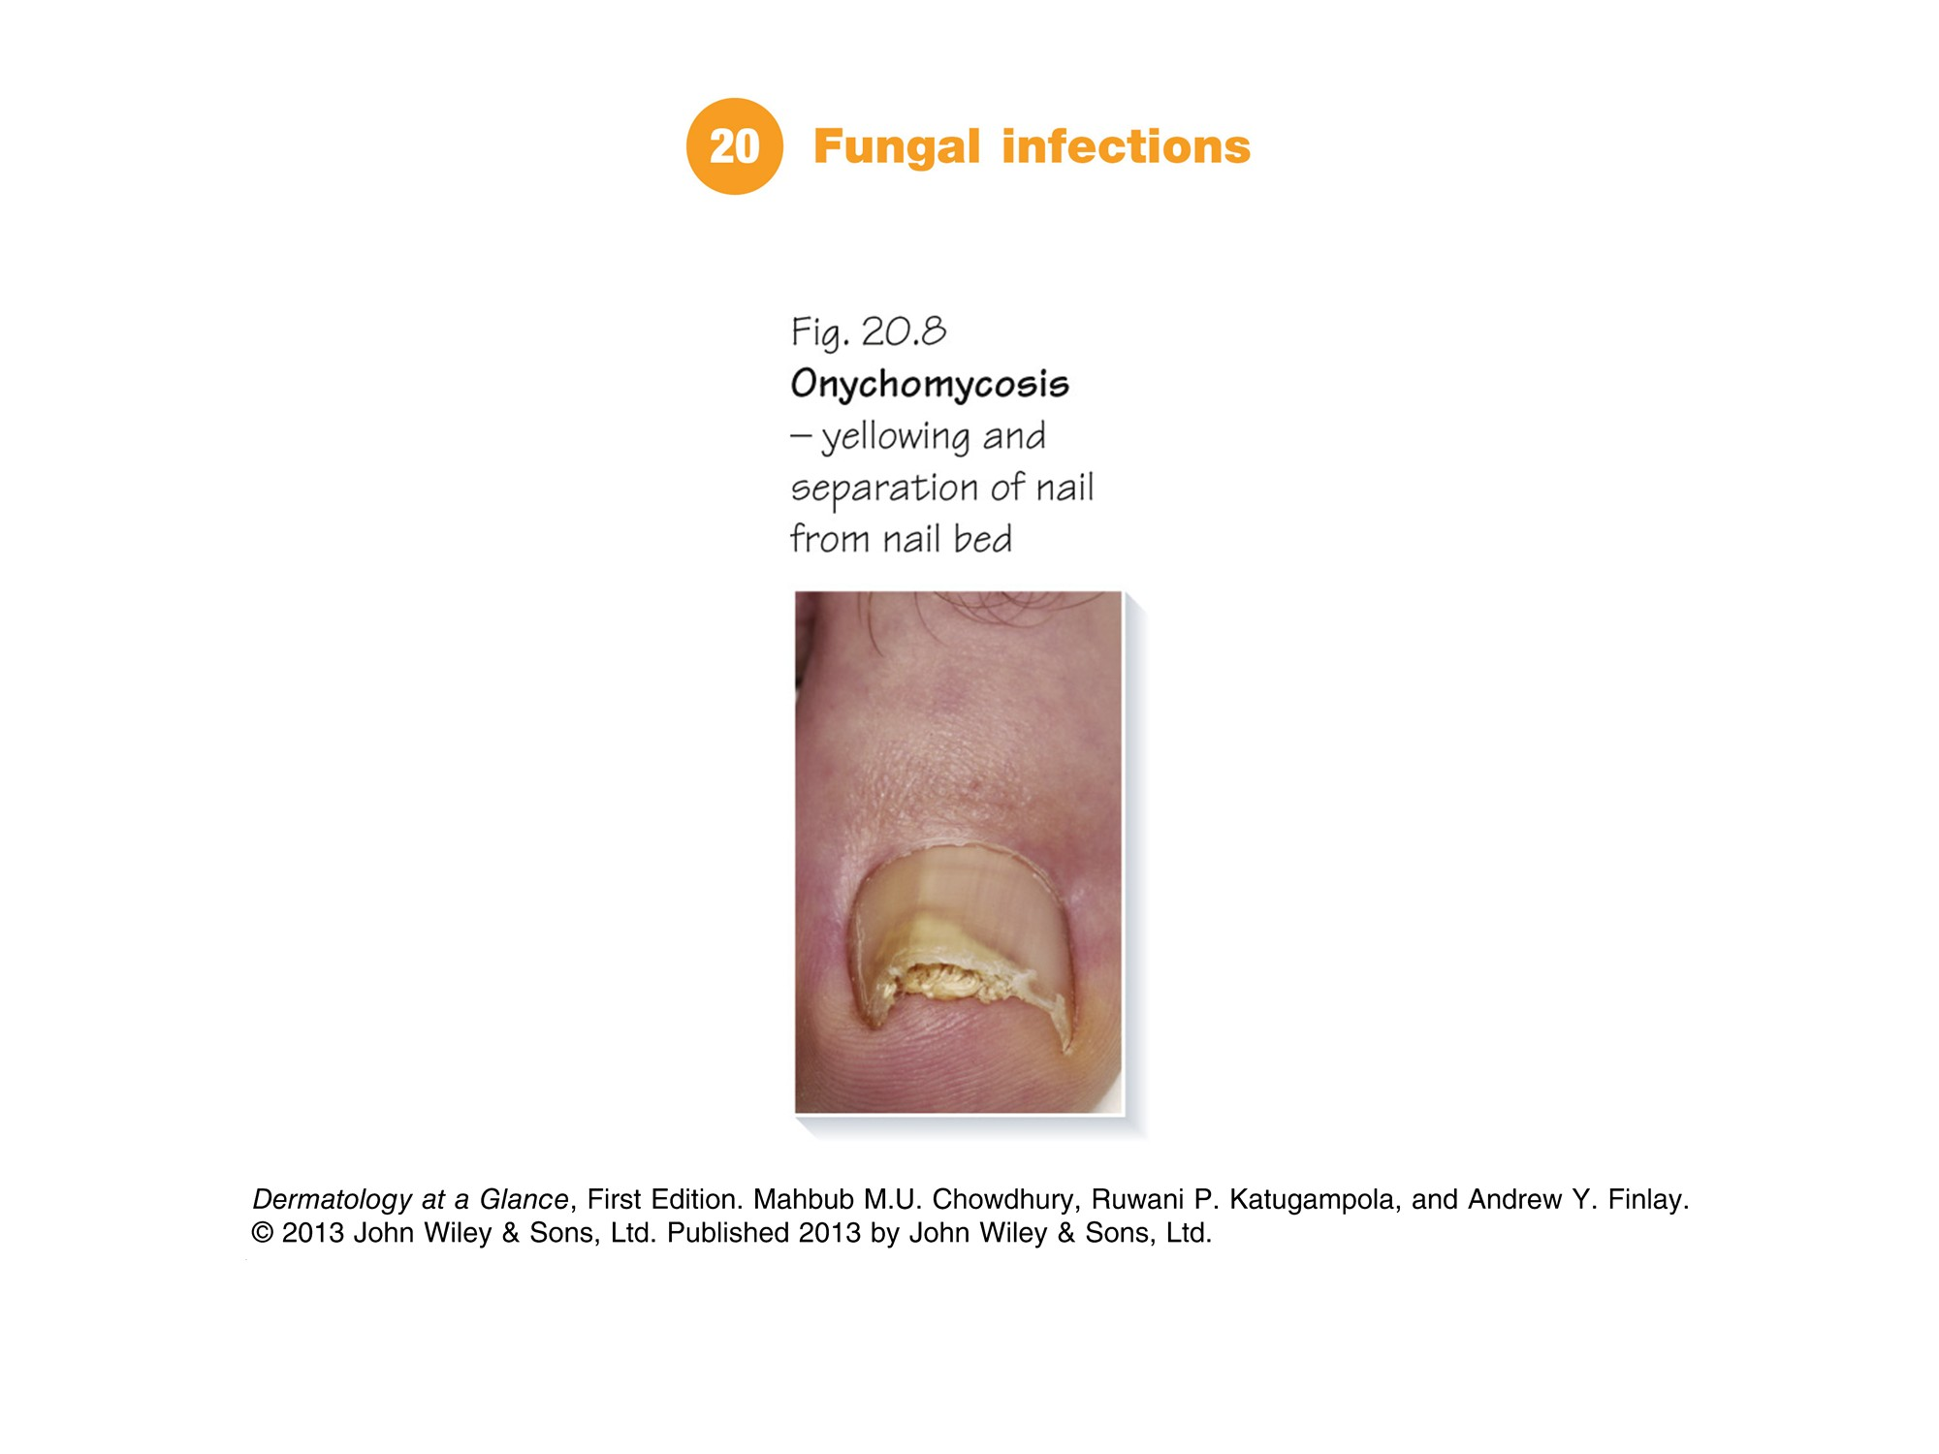

Slide 8
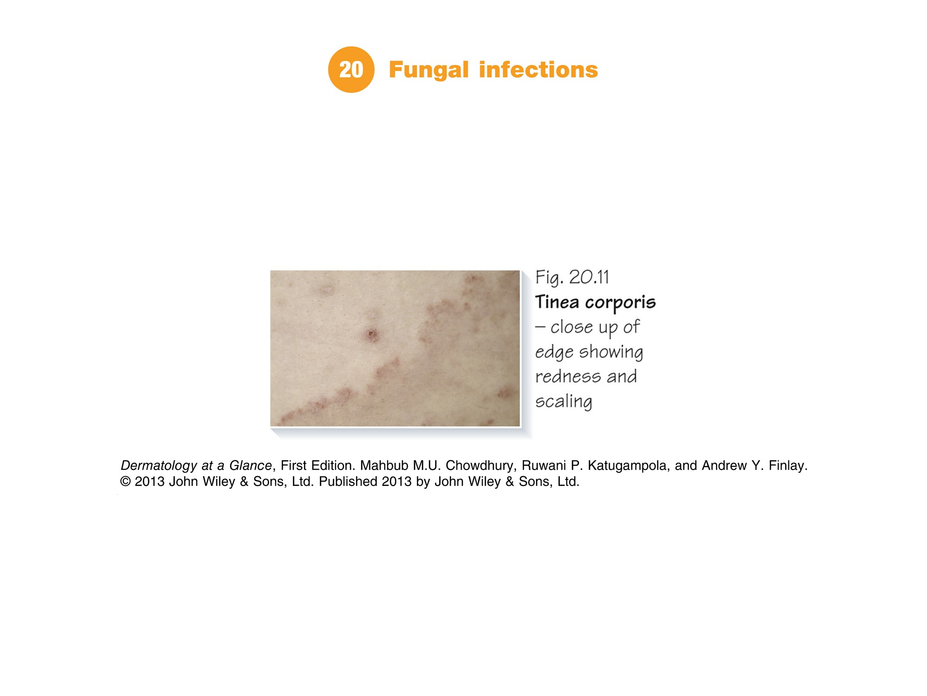

Slide 9
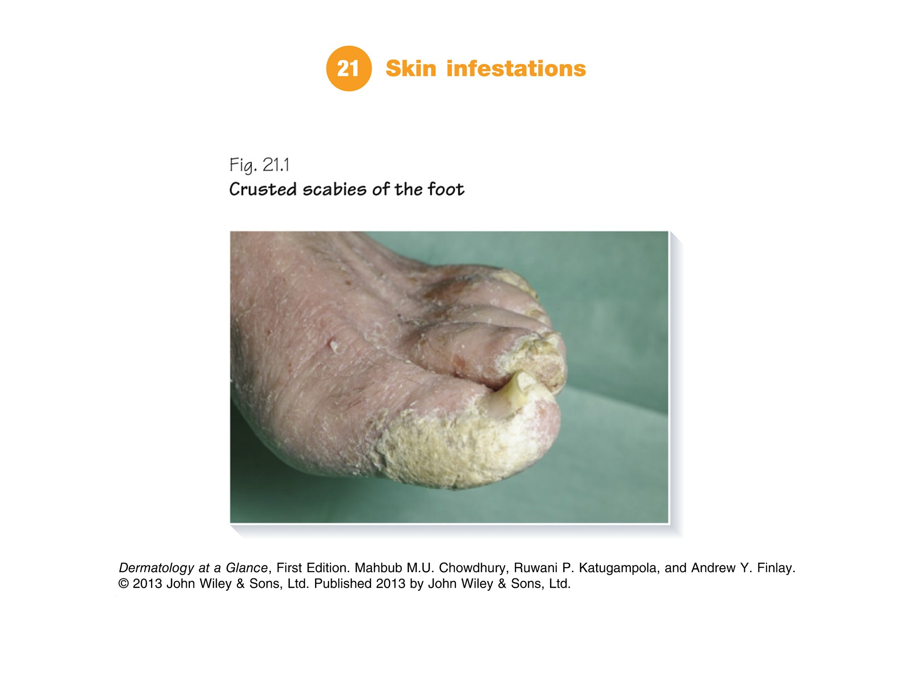

Slide 10
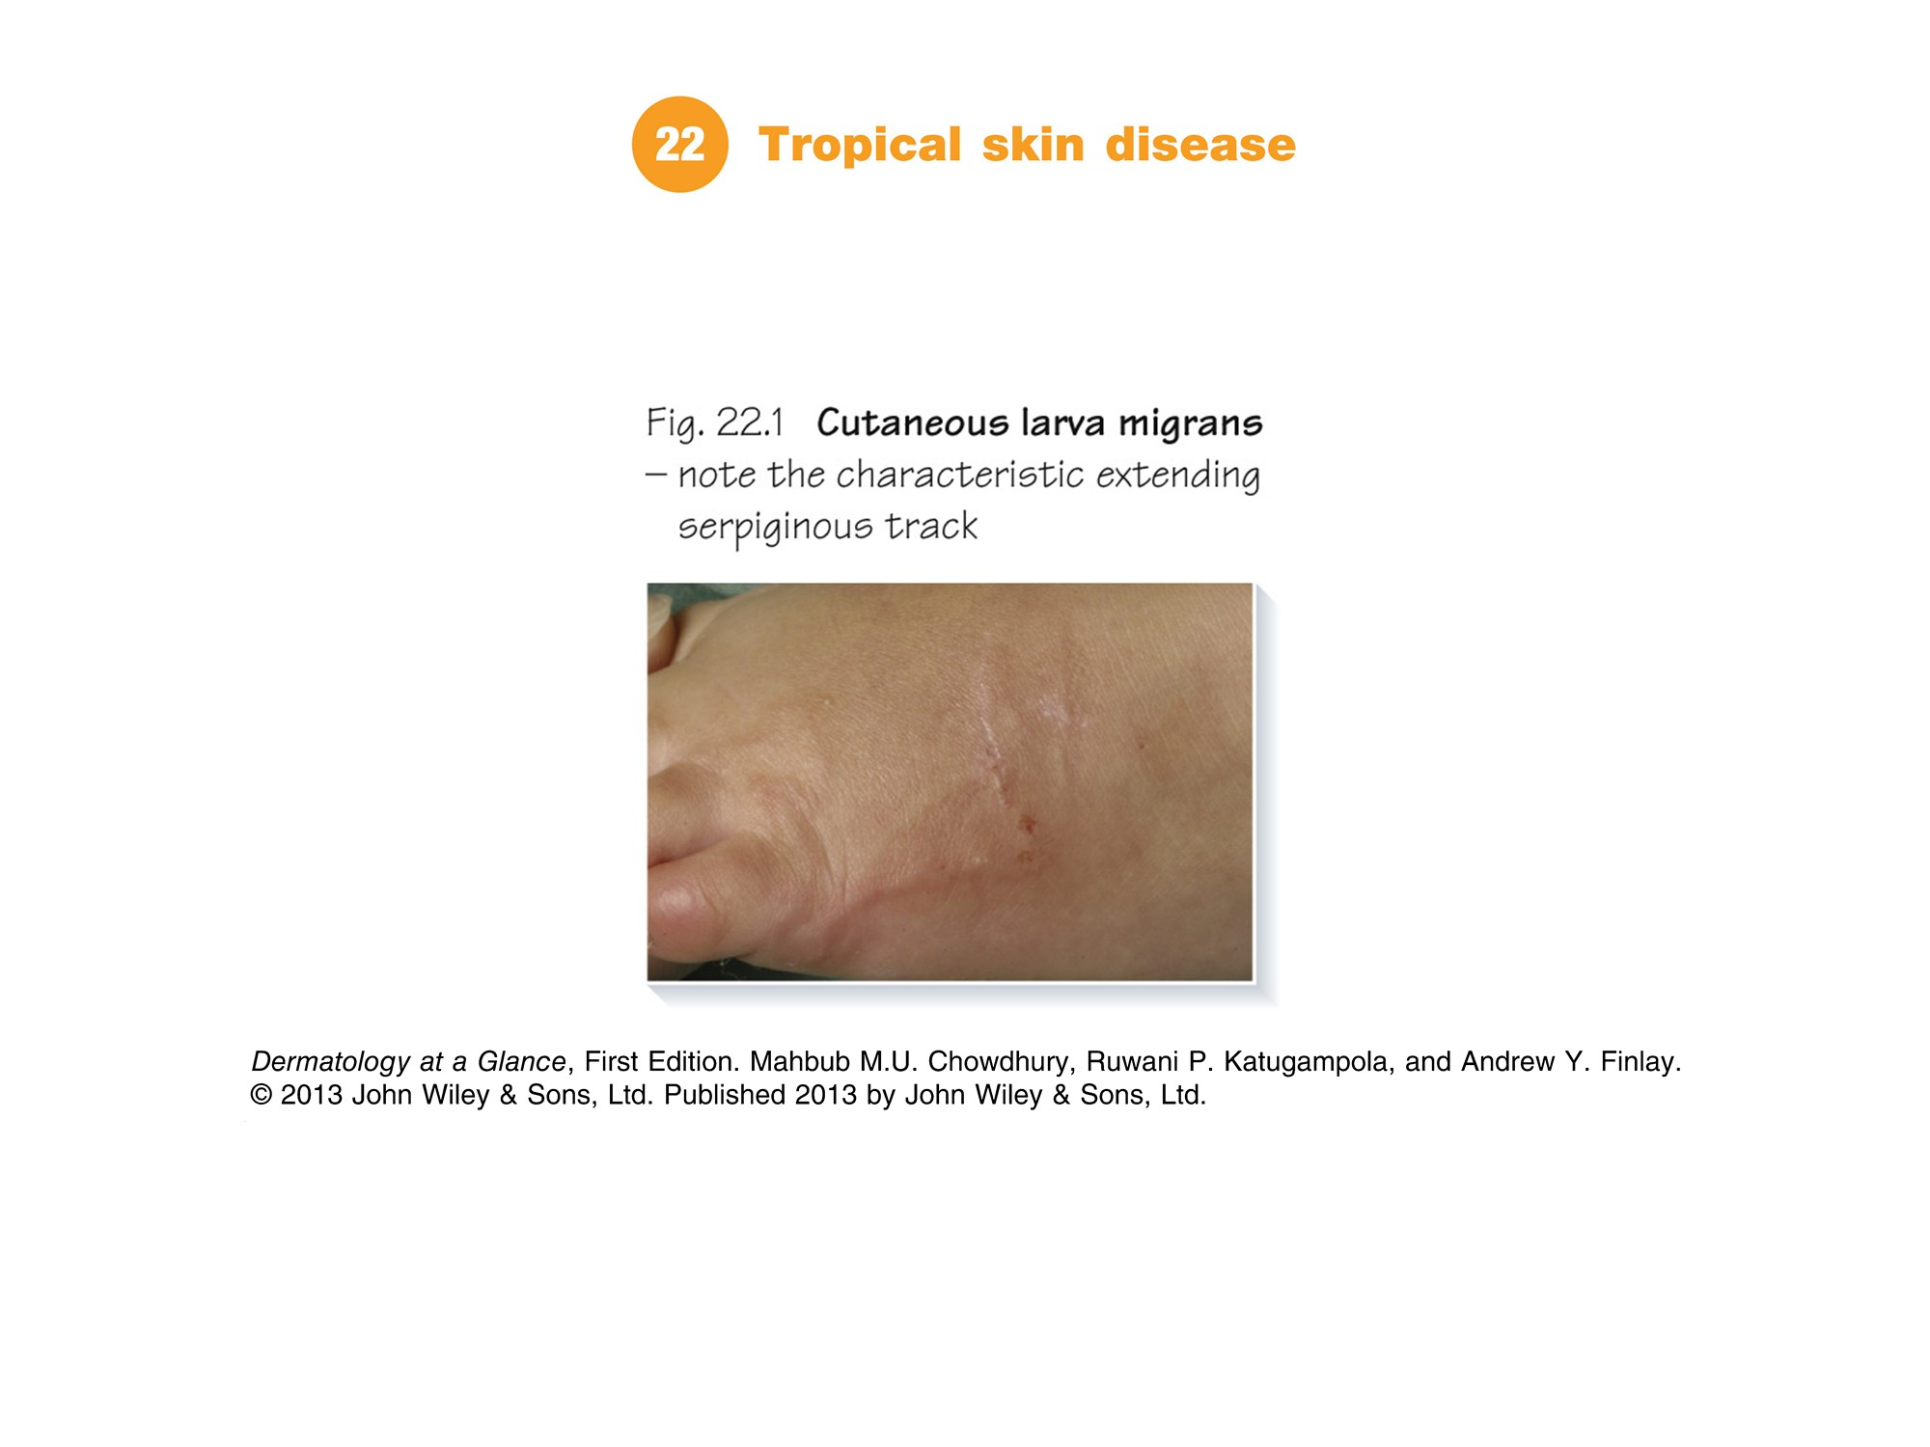

Slide 11
